Slide 1
UNIT II
Basic Computer Organization and Design: Instruction codes, computer registers, computer instructions, timing and control, instruction cycle, memory-references instructions, input-output and interrupt complete computer description. Design of the basic computer, design of accumulator logic.
Micro programmed Control: Control memory, address sequencing, microprogram example, design of control unit.

Slide 2
Instruction Code :
An instruction code is a group of bits that instruct the computer to perform a specific operation.
It is usually divided into parts, each having its own particular interpretation.
The most basic part of an instruction code is its operation part.

Slide 3
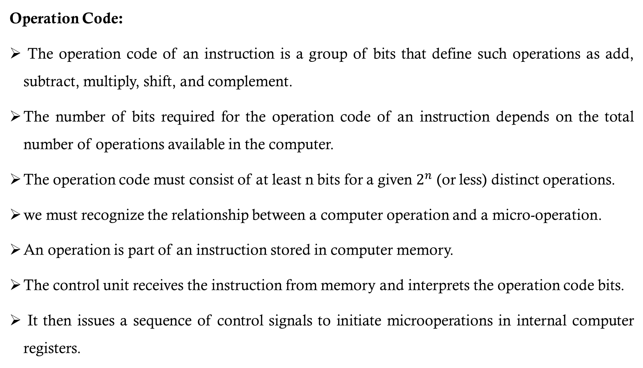
Operation Code:
The operation code of an instruction is a group of bits that define such operations as add, subtract, multiply, shift, and complement.
The number of bits required for the operation code of an instruction depends on the total number of operations available in the computer.
The operation code must consist of at least n bits for a given $2^{n}$ (or less) distinct operations.
we must recognize the relationship between a computer operation and a micro-operation.
An operation is part of an instruction stored in computer memory.
The control unit receives the instruction from memory and interprets the operation code bits.
It then issues a sequence of control signals to initiate microoperations in internal computer registers.

Slide 4
The operation part of an instruction code specifies the operation to be performed.
This operation must be performed on some data stored in processor registers or in memory.
An instruction code must therefore specify not only the operation but also the registers or the memory words where the operands are to be found,
as well as the register or memory word where the result is to be stored.
Memory words can be specified in instruction codes by their address.

Slide 5
Stored Program Organization
The simplest way to organize a computer is to have one processor register and an instruction code format with two parts.
The first part specifies the operation to be performed and the second specifies an address.
The memory address tells the control where to find an operand in memory.
This operand is read from memory and used as the data to be operated on together with the data stored in the processor register.

Slide 7
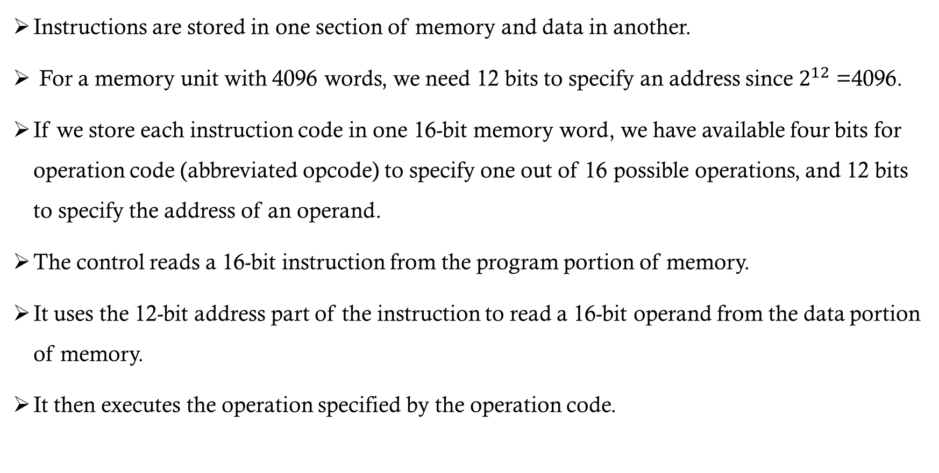
Instructions are stored in one section of memory and data in another.
For a memory unit with 4096 words, we need 12 bits to specify an address since $2^{12}$ =4096.
If we store each instruction code in one 16-bit memory word, we have available four bits for operation code (abbreviated opcode) to specify one out of 16 possible operations, and 12 bits to specify the address of an operand.
The control reads a 16-bit instruction from the program portion of memory.
It uses the 12-bit address part of the instruction to read a 16-bit operand from the data portion of memory.
It then executes the operation specified by the operation code.

Slide 8
Computers that have a single-processor register usually assign to it the name Accumulator and label it AC.
If an operation in an instruction code does not need an operand from memory, the rest of the bits in the instruction can be used for other purposes.
For example, operations such as clear AC, complement AC, and increment AC operate on data stored in the AC register.
They do not need an operand from memory.
For these types of operations, the second part of the instruction code (bits 0 through 11) is not needed for specifying a memory address and can be used to specify other operations for the computer.

Slide 9
Direct and Indirect addressing
The second part of an instruction format specifies the address of an operand, the instruction is said to have a direct address.
In Indirect address, the bits in the second part of the instruction designate an address of a memory word in which the address of the operand is found.
One bit of the instruction code can be used to distinguish between a direct and an indirect address.
It consists of a 3-bit operation code, a 12-bit address, and an indirect address mode bit designated by I.
The mode bit is 0 for a direct address and 1 for an indirect address.

Slide 10
Direct addressing
Indirect addressing
22
0
ADD
457
35
1
ADD
300
300
1350
457
Operand
1350
Operand
+
+
AC
AC

Slide 11
A direct address instruction is shown in the above fig. It is placed in address 22 in memory.
The I bit is 0, so the instruction is recognized as a direct address instruction.
The opcode specifies an ADD instruction, and the address part is the binary equivalent of 457.
The control finds the operand in memory at address 457 and adds it to the content of AC.
The instruction in address 35 shown in above Fig. has a mode bit I = 1, recognized as an indirect address instruction.
The address part is the binary equivalent of 300.
The control goes to address 300 to find the address of the operand.
The address of the operand, in this case, is 1350.
The operand found in address 1350 is then added to the content of AC

Slide 12
Computer Registers
Computer instructions are normally stored in consecutive memory locations and are executed sequentially one at a time.
The control reads an instruction from a specific address in memory and executes it.
It then continues by reading the next instruction in sequence and executing it, and so on.
This type of instruction sequencing needs a counter to calculate the address of the next instruction after the execution of the current instruction is completed.
It is necessary to provide a register in the control unit for storing the instruction code after it is read from memory.
The computer needs processor registers for manipulating data and a register for holding a memory address

Slide 15
The data register (DR) holds the operand read from memory.
The accumulator (AC) register is a general-purpose processing register.
The instruction read from memory is placed in the instruction register (IR).
The temporary register (TR) is used for holding temporary data during the processing.
The memory address register (AR) has 12 bits.
The program counter (PC) also has 12 bits and it holds the address of the next instruction to be read from memory after the current instruction is executed.
Instruction words are read and executed in sequence unless a branch instruction is encountered. A branch instruction calls for a transfer to a nonconsecutive instruction in the program.
Two registers are used for input and output. The input register (INPR) receives an 8-bit character from an input device. The output register (OUTR) holds an 8-bit character for an output device.

Slide 16
Common Bus System
The basic computer has eight registers, a memory unit, and a control unit.
Paths must be provided to transfer information from one register to another and between memory and registers.
A more efficient scheme for transferring information in a system with many registers is to use a common bus

Slide 18
Read
INPR
Memory
4096 x 16
Write
Address
E
ALU
AC
L
I
C
L
I
C
L
L
I
C
DR
IR
L
I
C
PC
TR
AR
OUTR
LD
L
I
C
7
1
2
3
4
5
6
16-bit Common Bus

Slide 19
The basic computer has eight registers, a memory unit and a control unit.
Paths must be provided to transfer information from one register to another and between memory and register
An efficient scheme for transferring information in a system with many register is to use a common bus
The connection of the registers and memory of the basic computer to a common bus system is shown
The outputs of registers and memory are connected to the common bus.
The specific output that is selected for the bus lines at any given time is determined from the binary value of the selection variables S2, S1, and S0.
The number along each output shows the decimal equivalent of the required binary selection.

Slide 20
The particular register whose LD (load) input is enabled receives the data from the bus during the next clock pulse transition. The memory receives the contents of the bus
when its write input is activated. The memory places its 16-bit output onto the bus when the read input is activated and S2 S1 S0 = 1 1 1.
Four registers, DR, AC, IR, and TR have 16 bits each.
Two registers, AR and PC, have 12 bits each since they hold a memory address.
When the contents of AR or PC are applied to the 16-bit common bus, the four most significant bits are set to 0’s.
When AR and PC receive information from the bus, only the 12 least significant bits are transferred into the register.
The input register INPR and the output register OUTR has 8 bits each and communicate with the eight least significant bits in the bus.
INPR is connected to provide information to the bus but OUTR can only receive information from the bus

Slide 21
Five registers have three control inputs: LD (load), INR (increment), and CLR (clear). Two registers have only an LD input.
AR must always be used to specify a memory address; therefore memory address is connected to AR.
The 16 inputs of AC come from an adder and logic circuit. This circuit has three sets of inputs.
1. Set of 16-bit inputs come from the outputs of AC.
2. Set of 16-bits comes from the data register DR.
3. Set of 8-bit inputs comes from the input register INPR.
The result of an addition is transferred to AC and the end carry-out of the addition is transferred to flip-flop E (extended AC bit).
The clock transition at the end of the cycle transfers the content of the bus into the designated destination register and the output of the adder and logic circuit into AC

Slide 22
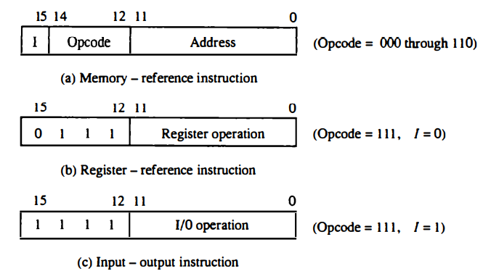
Computer Instructions
The basic computer has three instruction code formats and Each format has 16 bits.
The operation code (opcode) part of the instruction contains three bits and the meaning of the remaining 13 bits depends on the operation code encountered.

Slide 23
A memory-reference instruction uses 12 bits to specify an address and one bit to specify the addressing mode I. I is equal to 0 for direct address and 1 for indirect address.
The register reference instructions are recognized by the operation code 111 with a 0 in the leftmost bit (bit 15) of the instruction.
A register-reference instruction specifies an operation on or a test of the AC register.
An operand from memory is not needed and the other 12 bits are used to specify the operation or test to be executed.
an input-output instruction does not need a reference to memory and is recognized by the operation code 111 with a 1 in the leftmost bit of the instruction.
The remaining 12 bits are used to specify the type of input-output operation or test performed

Slide 24
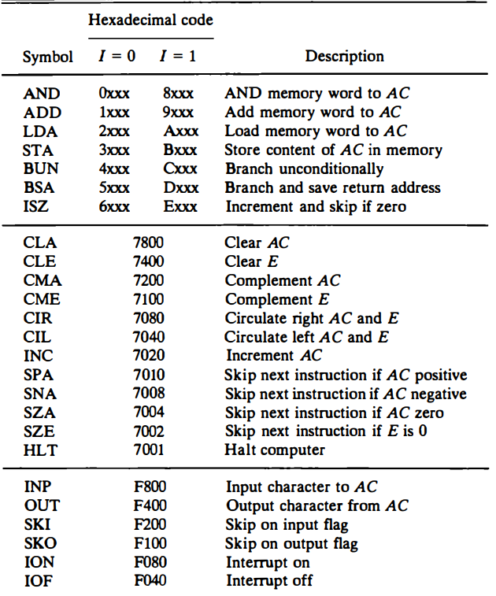

Slide 25
The hexadecimal code is equal to the equivalent hexadecimal number of the binary code used for the instruction.
A memory-reference instruction has an address part of 12 bits. The address part is denoted by three x’s
The last bit of the instruction is designated by the symbol I. When I = 0, the last four bits of instruction have a hexadecimal digit equivalent from 0 to 6 since the last bit is 0.
When I = I, the hexadecimal digit equivalent of the last four bits of the instruction ranges from 8 to E.
Register-reference instructions use 16 bits to specify an operation. The leftmost four bits are always 0111, which is equivalent to hexadecimal 7.
The other three hexadecimal digits give the binary equivalent of the remaining 12 bits.
The input-output instructions also use all 16 bits to specify an operation. The last four bits are always 1111, equivalent to hexadecimal F.

Slide 26
Instruction Set Completeness
The set of instructions are said to be complete if the computer includes a sufficient number of instructions in each of the following categories:
Arithmetic, logic, and shift instructions
Instructions for moving information to and from memory and processor registers
Program control instructions together with instructions that check status conditions
Input and output instructions

Slide 27
Timing and Control
The timing for all registers in the basic computer is controlled by a master clock generator.
The clock pulses are applied to all flip-flops and registers in the system.
The clock pulses do not change the state of a register unless the register is enabled by a control signal.
The control signals are generated in the control unit and provide control inputs for the multiplexers in the common bus, control inputs in processor registers, and micro operations for the accumulator
There are two major types of control organization: hardwired control and microprogrammed control.

Slide 28
The hardwired organization, the control logic is implemented with gates, flip-flops, decoders, and other digital circuits.
The advantage is that it can be optimized to produce a fast mode of operation
In the microprogrammed organization, the control information is stored in the control memory.
The control memory is programmed to initiate the required sequence of microoperations
In the microprogrammed control, any required changes or modifications can be done by updating the microprogram in control memory.

Slide 29
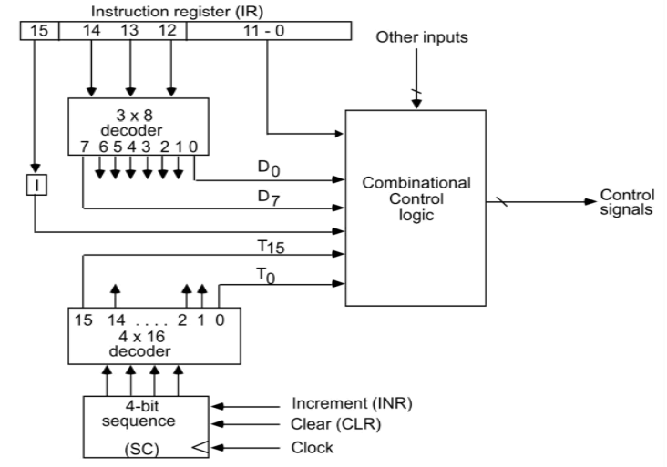

Slide 30
Components of Control unit are
Two decoders
A sequence counter
Control logic gates
An instruction read from memory is placed in the instruction register (IR).
In the control unit the IR is divided into three parts: I bit, the operation code (12-14)bit, and bits 0 through 11.
The operation code in bits 12 through 14 are decoded with a 3 X 8 decoder.
Bit-15 of the instruction is transferred to a flip-flop designated by the symbol I.
The eight outputs of the decoder are designated by the symbols D0 through D7.
Bits 0 through 11 are applied to the control logic gates.

Slide 31
The 4‐bit sequence counter can count in binary from 0 through 15.
The outputs of the counter are decoded into 16 timing signals T0 through T15.
The sequence counter SC can be incremented or cleared synchronously.
Most of the time, the counter is incremented to provide the sequence of timing signals out of 4 X 16 decoder.
Once in a while, the counter is cleared to 0, causing the next timing signal to be T0.
As an example, consider the case where SC is incremented to provide timing signals T0, T1, T2, T3 and T4 in sequence.
At time T4, SC is cleared to 0 if decoder output D3 is active This is expressed symbolically by the statement
D3T4: SC ← 0

Slide 32
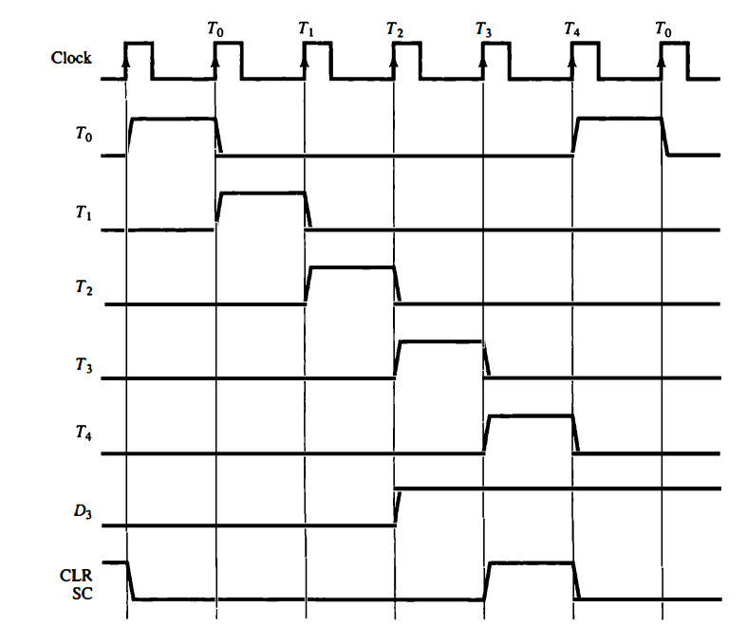
Timing Diagram

Slide 33
The timing shows the time relationship of the control signals.
The sequence counter SC responds to the positive transition of the clock.
Initially, the CLR input of SC is active.
The first positive transition of the clock clears SC to 0, which in turn activates the timing T0 out of the decoder.
T0 is active during one clock cycle.
The positive clock transition labeled T0 in the diagram will trigger only those registers whose control inputs are connected to timing signal T0
SC is incremented with every positive clock transition unless its CLR input is active.
This procedures the sequence of timing signals T0, T1, T2, T3 and T4, and so on.
If SC is not cleared, the timing signals will continue with T5, T6, up to T15 and back to T0.

Slide 34
The last three waveforms show how SC is cleared when D3T4 = 1.
Output D3 from the operation decoder becomes active at the end of timing signal T2.
When timing signal T4 becomes active, the output of the AND gate that implements the control function D3T4 becomes active.
This signal is applied to the CLR input of SC. On the next positive clock transition, the counter is cleared to 0.
This causes the timing signal T0 to become active instead of T5 that would have been active if SC were incremented instead of cleared.

Slide 35
Instruction Cycle
A program residing in the memory unit of the computer consists of a sequence of instructions.
The program is executed in the computer by going through a cycle for each instruction.
Each instruction cycle in turn is subdivided into a sequence of subcycles or phases.
Each instruction cycle consists of the following phases:
1. Fetch instruction from memory.
2. Decode the instruction.
3. Read the effective address from memory if the instruction has an indirect address.
4. Execute the instruction.

Slide 36
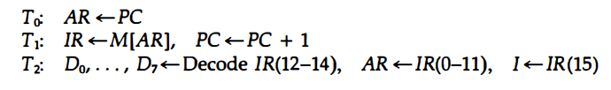
Fetch and Decode:
Initially, the program counter PC is loaded with the address of the first instruction in the program.
The sequence counter SC is cleared to 0, providing a decoded timing signal To.
After each clock pulse, SC is incremented by one, so that the timing signals go through a sequence T0, T1, T2, and so on.
The micro operations for the fetch and decode phases are

Slide 37
Only AR is connected to the address inputs of memory, it is necessary to transfer the address from PC to AR during the clock transition associated with timing signal T0
The instruction read from memory is then placed in the instruction register IR with the clock transition associated with timing signal T1
At the same time, PC is incremented by one to prepare it for the address of the next instruction in the program.
At time T2, the operation code in IR is decoded, the mode bit is transferred to flip-flop I, and the address part of the instruction is transferred to AR

Slide 38
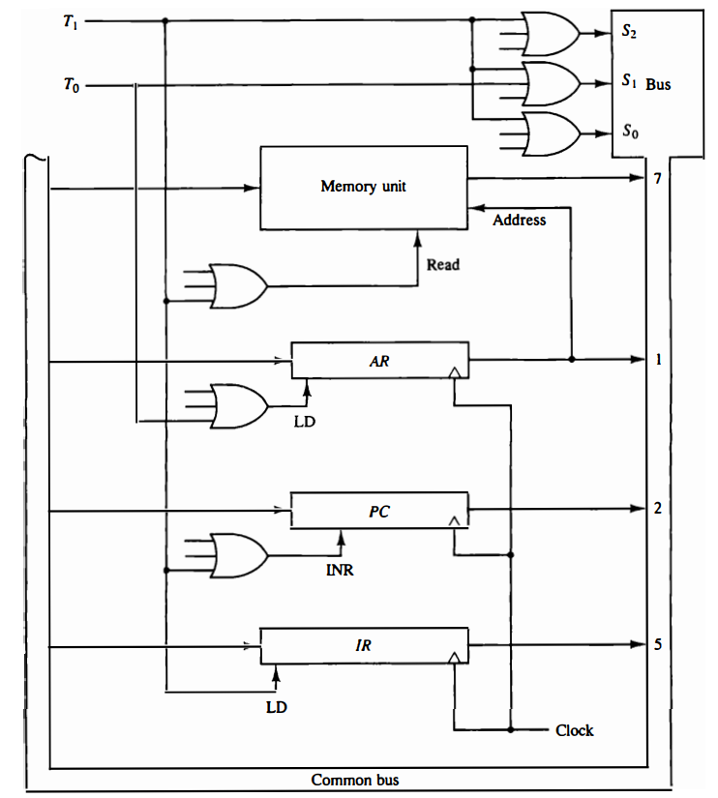


Slide 39
To provide the data path for the transfer of PC to AR we must apply timing signal T0 to achieve the following connection:
1. Place the content of PC onto the bus by making the bus selection inputs S2S1S0 equal to 010.
2. Transfer the content of the bus to AR by enabling the LD input of AR .
The next clock transition initiates the transfer from PC to AR since T0 = 1 In order to implement the second statement
T1: IR ← M[AR], PC ← PC + 1
it is necessary to use timing signal T1 to provide the following connections in the bus system.
Enable the read input of memory.
Place the content of memory onto the bus by making S2S1S0 = 111.
Transfer the content of the bus to IR by enabling the LD input of IR.
Increment PC by enabling the INR input of PC.

Slide 40
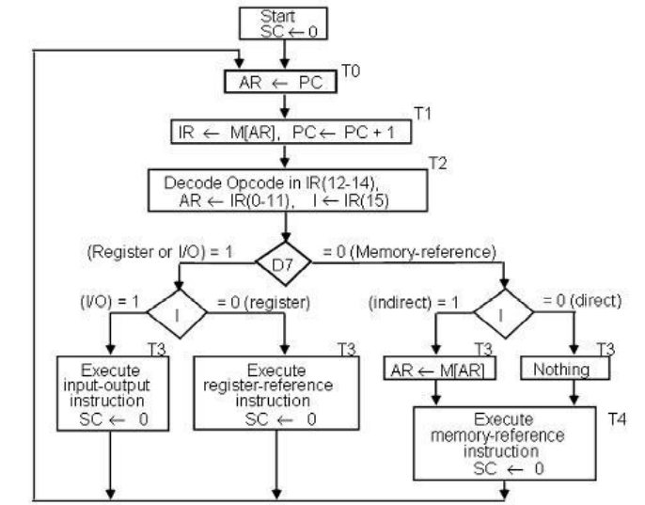
Determine the Type of Instruction:

Slide 41
The flowchart presents an initial configuration for the instruction cycle and shows how the controller determines the instruction type after the decoding.
If D7 = 1, the instruction must be register-reference or input-output type. If D7 = 0, the operation code must be one of the other seven values 110, specifying a memory reference instruction.
Control then inspects the value of the first bit of the instruction, which is now available in flip-flop I.
If D7 = 0 and I = 1, we have a memory-reference instruction with an indirect address. It is then necessary to read the effective address from memory.
The three instruction types are subdivided into four separate paths.
The selected operation is activated with the clock transition associated with timing signal T3.

Slide 42
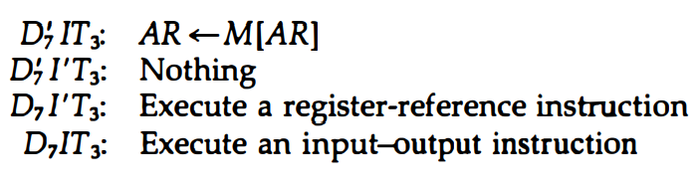
When a memory-reference instruction with I = 0 is encountered, it is not necessary to do anything since the effective address is already in AR.
However, the sequence counter SC must be incremented when D’7 I T3 = 1 so that the execution of the memory-reference instruction can be continued with timing variable T4.
A register-reference or input-output instruction can be executed with the clock associated with timing signal T3.
After the instruction is executed, SC is cleared to 0, and control returns to the fetch phase with T0 =1. SC is either incremented or cleared to 0 with every positive clock transition

Slide 43
Register-Reference Instructions
Register-reference instructions are recognized by the control when D7 = 1 and I = 0.
These instructions use bits 0 through 11 of the instruction code to specify one of the 12 instructions.
These 12 bits are available in IR(0-11).
They were also transferred to AR during time T2.
These instructions are executed with the clock transition associated with timing variable T3
Each control function needs the Boolean relation D7I'T3

Slide 44
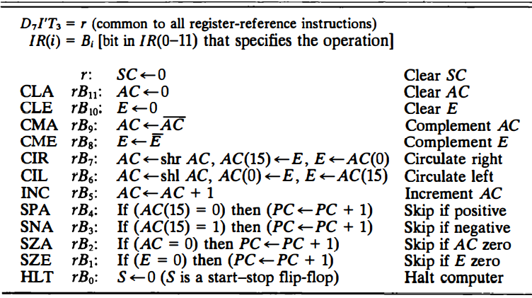

Slide 45
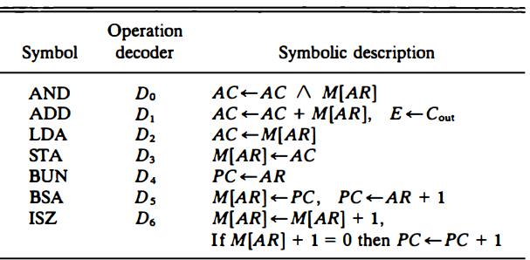
Memory-Reference Instructions
The effective address of the instruction is in the address register AR and was placed there during timing signal T2 when I = 0, or during timing signal T3 when I = 1.
The execution of the memory-reference instructions starts with timing signal T4

Slide 46





AND to AC:
ADD to AC:
LDA: Load to AC:
STA: Store AC:
BUN: Branch Unconditionally:

Slide 47


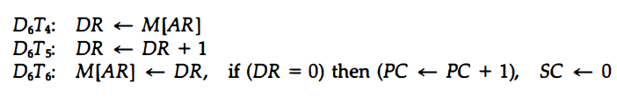
BSA: Branch and Save Return Address:
It is not possible to perform the operation of the BSA instruction in one clock cycle when we use the bus system of the basic computer.
To use the memory and the bus properly, the BSA instruction must be executed With a sequence of two microoperations:
ISZ: Increment and Skip if Zero:

Slide 48
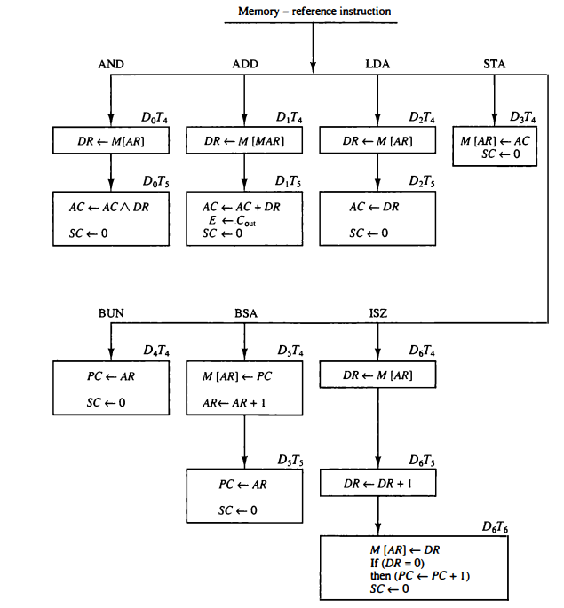

Slide 49
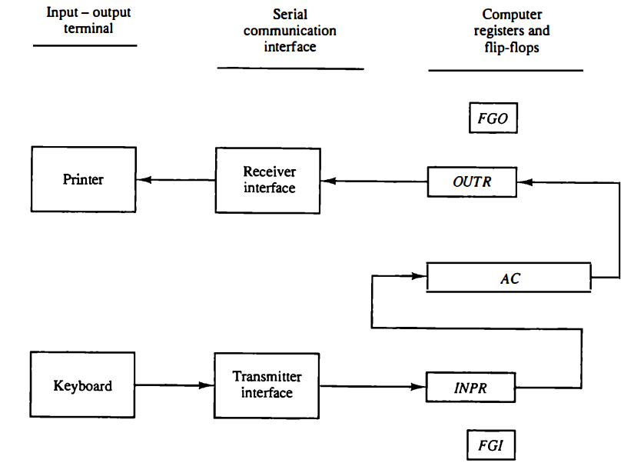
Input-Output and Interrupt
Instructions and data stored in memory must come from some input device.
Computational results must be transmitted to the user through some output device.

Slide 50
The terminal sends and receives serial information. Each quantity of information has eight bits of an alphanumeric code.
The serial information from the keyboard is shifted into the input register INPR.
The serial information for the printer is stored in the output register OUTR.
These two registers communicate with a communication interface serially and with the AC in parallel.
The transmitter interface receives serial information from the keyboard and transmits it to INPR.
The receiver interface receives information from OUTR and sends it to the printer serially

Slide 51
The input register INPR consists of eight bits and holds alphanumeric input information.
The 1-bit input flag FGI is a control flip-flop.
The flag bit is set to 1 when new information is available in the input device and is cleared to 0 when the information is accepted by the computer.
The output register OUTR works similarly but the direction of information flow is reversed. Initially, the output flag FGO is set to 1.
The computer checks the flag bit; if it is 1, the information from AC is transferred in parallel to OUTR, and FGO is cleared to 0.
The output device accepts the coded information, prints the corresponding character, and when the operation is completed, it sets FGO to 1.

Slide 52
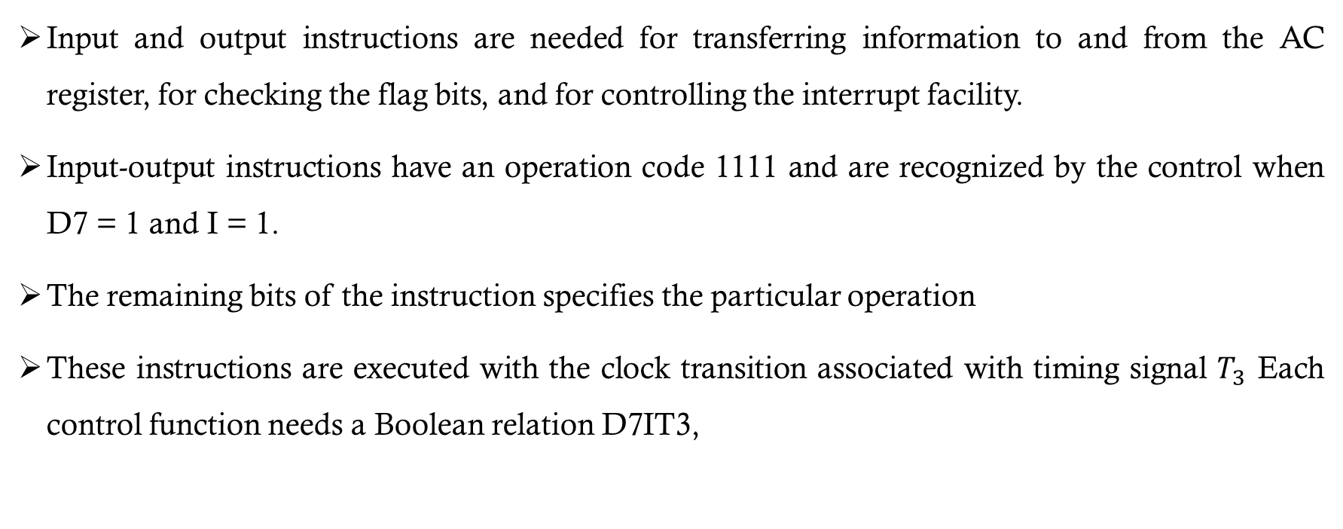
Input-Output Instructions
Input and output instructions are needed for transferring information to and from the AC register, for checking the flag bits, and for controlling the interrupt facility.
Input-output instructions have an operation code 1111 and are recognized by the control when D7 = 1 and I = 1.
The remaining bits of the instruction specifies the particular operation
These instructions are executed with the clock transition associated with timing signal $T_{3}$ Each control function needs a Boolean relation D7IT3,

Slide 53
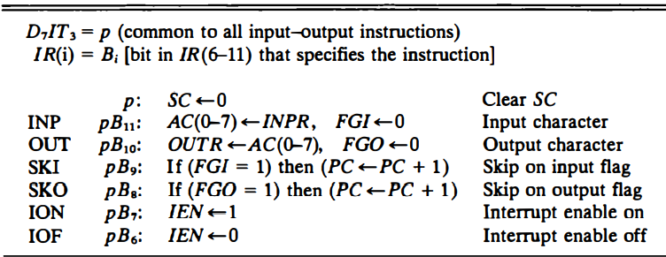

Slide 54
Program Interrupt
The programmed controlled procedure is to let the external device inform the computer when it is ready for the transfer.
While the computer is running a program, it does not check the flags.
However, when a flag is set, the computer is momentarily interrupted from proceeding with the current program and is informed of the fact that a flag has been set.
The computer deviates momentarily from what it is doing to take care of the input or output transfer.
It then returns to the current program to continue what it was doing before the interrupt.
The interrupt enable flip-flop IEN can be set and cleared with two instructions.
When IEN is cleared to 0, the flags cannot interrupt the computer.
When IEN is set to 1 (with the ION instruction), the computer can be interrupted

Slide 55
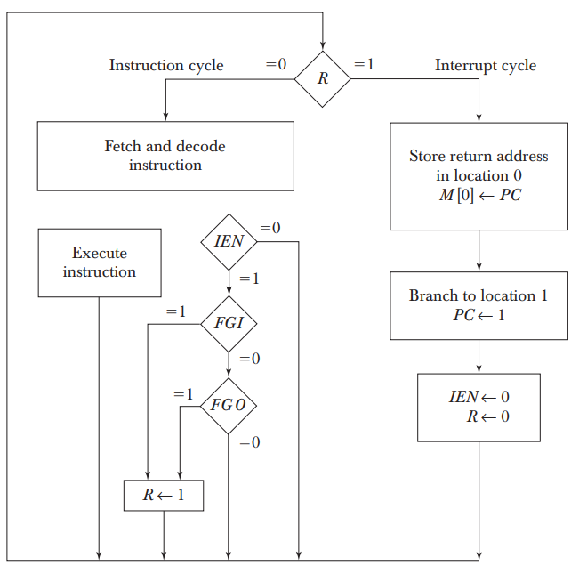

Slide 56
An interrupt flip-flop R is included in the computer.
When R 0, the computer goes through an instruction cycle.
During the execute phase of the instruction cycle IEN is checked by the control.
If it is 0, it indicates that the programmer does not want to use the interrupt, so control continues with the next instruction cycle.
If IEN is 1, control checks the flag bits.
If both flags are 0, it indicates that neither the input nor the output registers are ready for the transfer of information.
In this case, control continues with the next instruction cycle.
If either flag is set to 1 while IEN 1, flip-flop R is set to 1.
At the end of the execute phase, control checks the value of R, and if it is equal to 1, it goes to an interrupt cycle instead of an instruction cycle.

Slide 57
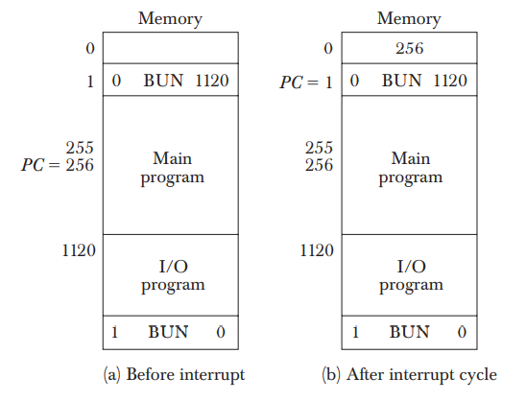

Slide 58
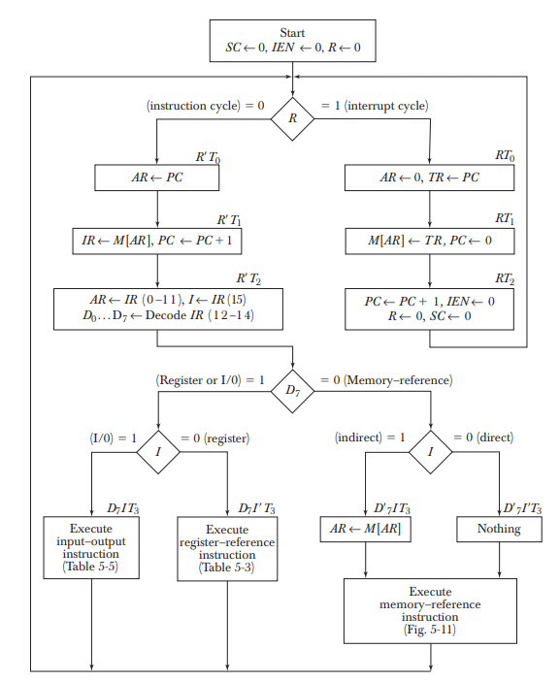
Complete Computer Description

Slide 59
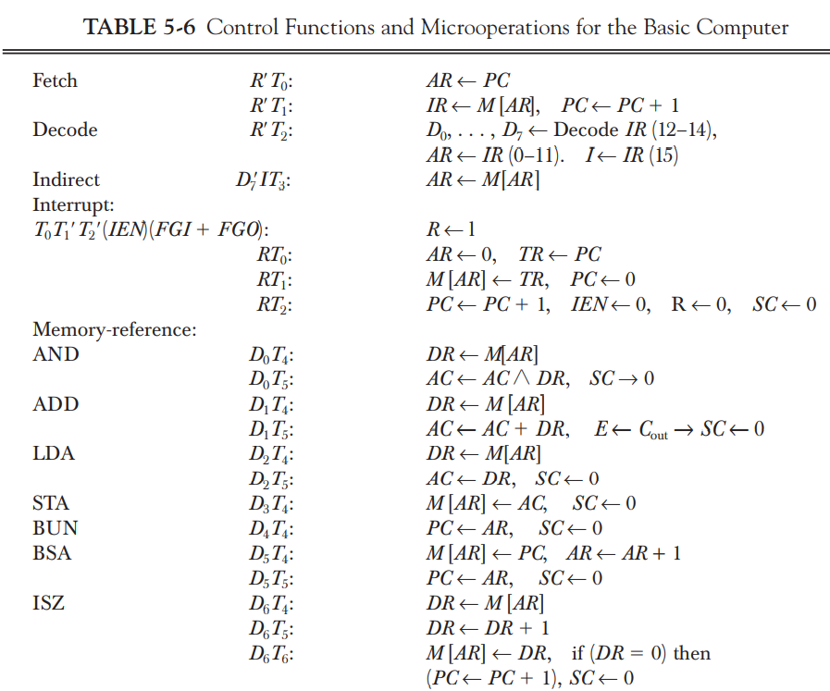

Slide 60
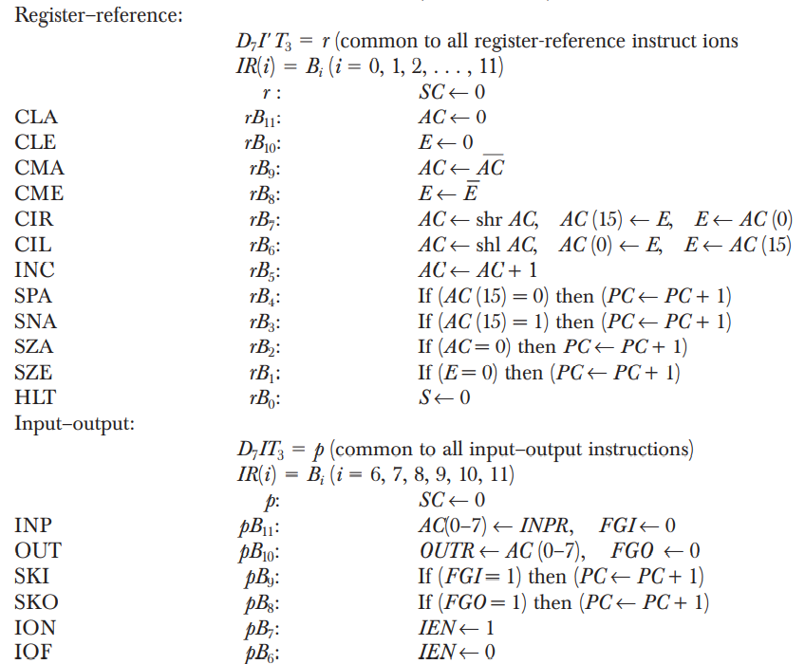

Slide 61
Design of Basic Computer
The basic computer consists of the following hardware components:
1. A memory unit with 4096 words of 16 bits each
2. Nine registers: AR, PC, DR, AC, IR, TR, OUTR, INPR, and SC
3. Seven flip-flops: I, S, E, R, IEN, FGI, and FGO
4. Two decoders: a 3 X 8 operation decoder and a 4 X 16 timing decoder
5. A 16-bit common bus
6. Control logic gates
7. Adder and logic circuit connected to the input of AC

Slide 62
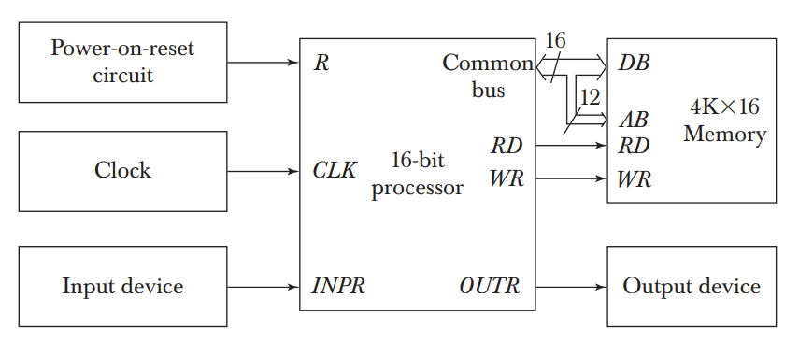
The functional block diagram of the hypothetic BASIC computer is as shown below:

Slide 63
Control Logic Gates:
The inputs to this circuit come from the two decoders, the I flip-flop, and bits 0 through 11 of IR.
The other inputs to the control logic are: AC bits 0 through 15 to check if AC= 0 and to detect the sign bit in AC(15); DR bits 0 through 15 to check if DR= 0; and the values of the seven flip-flops.
The outputs of the control logic circuit are:
1. Signals to control the inputs of the nine registers
2. Signals to control the read and write inputs of memory
3. Signals to set, clear, or complement the flip-flops
4. Signals for S2, S1, and S0 to select a register for the bus
5. Signals to control the AC adder and logic circuit

Slide 64
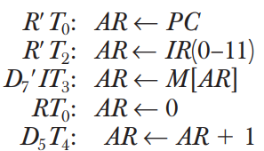
Control of Registers and Memory:
The control inputs of the registers are LD (load), INR (increment), and CLR (clear).
Suppose that we want to derive the gate structure associated with the control inputs of AR.
We scan Table 5.6 to find all the statements that change the content of AR:

Slide 65
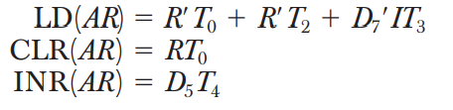
The first three statements specify transfer of information from a register or memory to AR.
The content of the source register or memory is placed on the bus and the content of the bus is transferred into AR by enabling its LD control input.
The fourth statement clears AR to 0.
The last statement increments AR by 1.
The control functions can be combined into three Boolean expressions as follows:

Slide 66
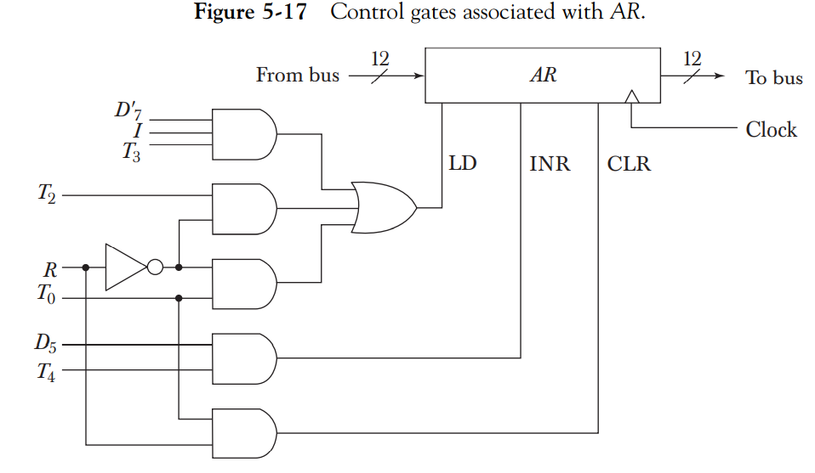

Slide 67


Control of Single Flip-flops:
The control gates for the seven flip-flops can be determined in a similar manner.
For example, Table 5.6 , shows that IEN may change as a result of the two instructions ION and IOF.
where p = D7IT3 and B7 and B6 are bits 7 and 6 of IR, respectively. Moreover, at the end of the interrupt cycle IEN is cleared to 0.

Slide 68
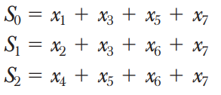
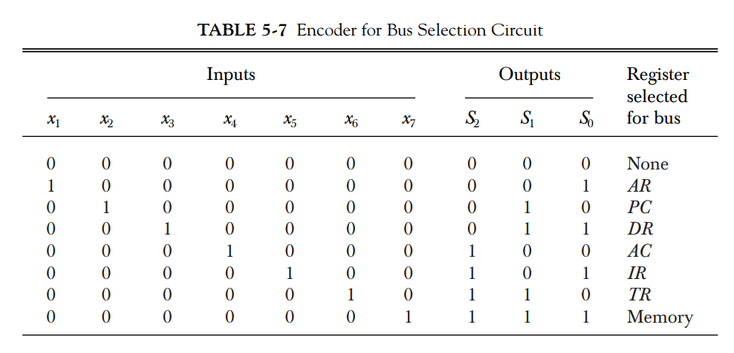
Control of Common Bus:
The 16-bit common bus is controlled by the selection inputs S 2, S1, and S0

Slide 69
Above table, specifies the binary numbers for S2S1S0 that select each register.
Each binary number is associated with a Boolean variable x1 through x7, corresponding to the gate structure that must be active in order to select the register or memory for the bus.
For example, when x1 = 1, the value of S2S1S0 must be 001 and the output of AR will be selected for the bus.
The Boolean functions for the encoder are

Slide 70
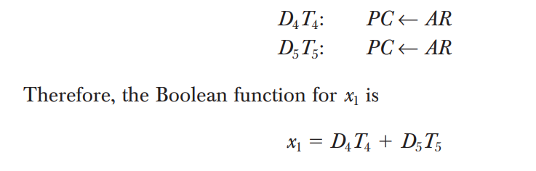
To determine the logic for each encoder input, it is necessary to find the control functions that place the corresponding register onto the bus.
For example, to find the logic that makes x1 = 1, we scan all register transfer statements in Table, and extract those statements that have AR as a source.

Slide 71
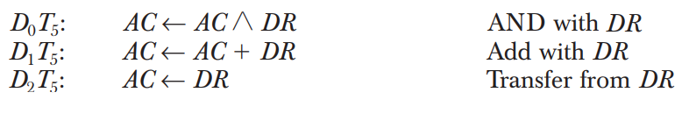
Design of Accumulator Logic
The circuits associated with the AC register are:
The adder and logic circuit has three sets of inputs.
One set of 16 inputs comes from the outputs of AC. Another set of 16 inputs comes from the data register DR. A third set of eight inputs comes from the input register INPR.
The outputs of the adder and logic circuit provide the data inputs for the register.
In order to design the logic associated with AC, it is necessary to go over the register transfer statements in Table 5-6 and extract all the statements that change the content of AC.

Slide 72
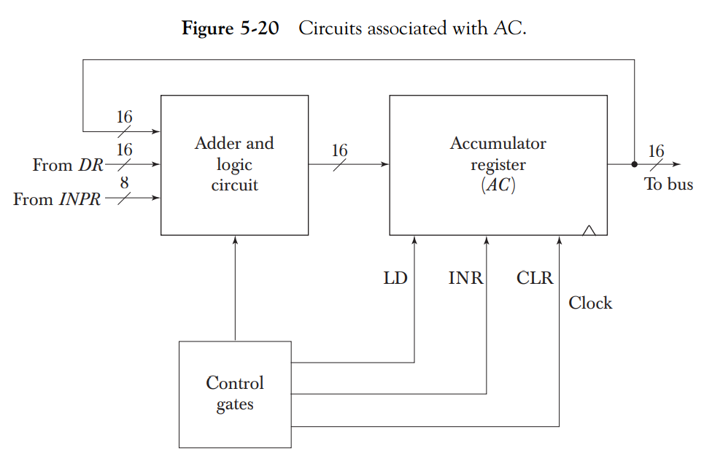

Slide 73
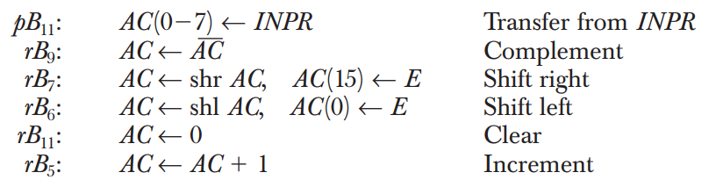

Slide 74
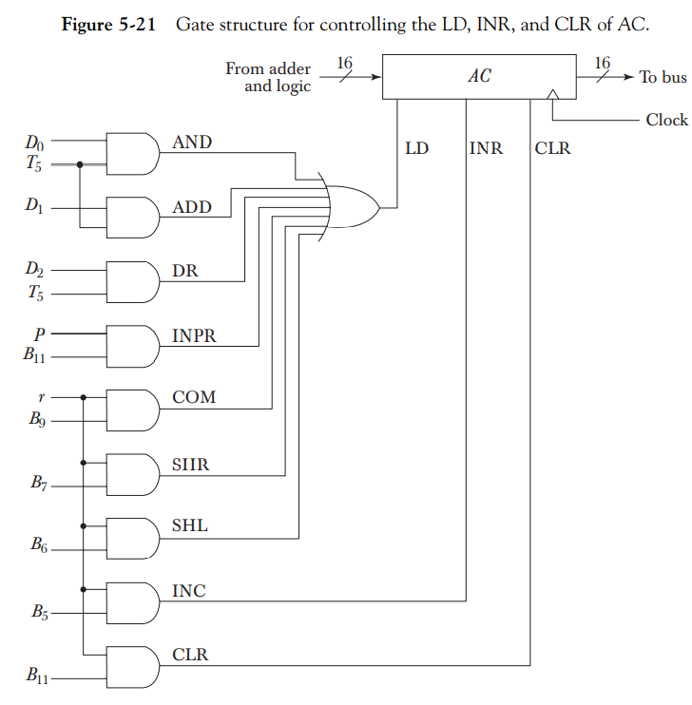
Control of AC Register:

Slide 75
